Slide 1
OBJECT ORIENTED
PROGRAMMING
Spring 2024
Miss Ayesha Majid

Slide 2
LECTURE – 3 - 4

Slide 3
Access Modifiers in Java
The access modifiers in Java specifies the accessibility or scope of a field, method, constructor, or class. We can change the access level of fields, constructors, methods, and class by applying the access modifier on it.
There are four types of Java access modifiers:
Private: The access level of a private modifier is only within the class. It cannot be accessed from outside the class.
Default: The access level of a default modifier is only within the package. It cannot be accessed from outside the package. If you do not specify any access level, it will be the default.
Protected: The access level of a protected modifier is within the package and outside the package through child class. If you do not make the child class, it cannot be accessed from outside the package.
Public: The access level of a public modifier is everywhere. It can be accessed from within the class, outside the class, within the package and outside the package.

Slide 4
Access Modifiers
We will be covering access modifiers in detail in future.

Slide 5
Java Methods
A method is a block of code which only runs when it is called.
You can pass data, known as parameters, into a method.
Methods are used to perform certain actions, and they are also known as functions.
Why use methods? To reuse code: define the code once, and use it many times.

Slide 6
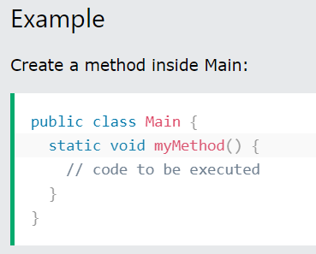
Create a Method
A method must be declared within a class. It is defined with the name of the method, followed by parentheses (). Java provides some pre-defined methods, such as System.out.println(), but you can also create your own methods to perform certain actions:

Slide 7
Example Explained
myMethod() is the name of the method
static means that the method belongs to the Main class and not an object of the Main class. You will learn more about objects and how to access methods through objects later in this tutorial.
void means that this method does not have a return value. You will learn more about return values later in this chapter

Slide 8
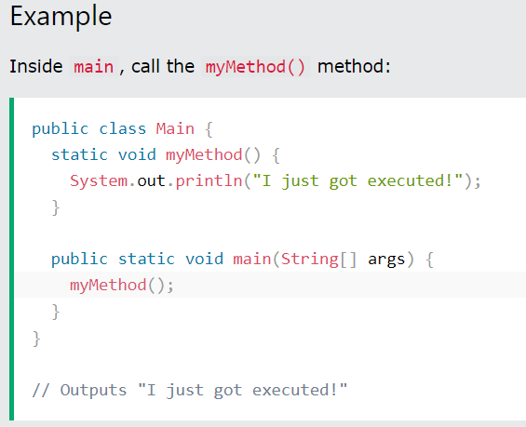
Call a Method
To call a method in Java, write the method's name followed by two parentheses () and a semicolon;
In the following example, myMethod() is used to print a text (the action), when it is called:

Slide 9
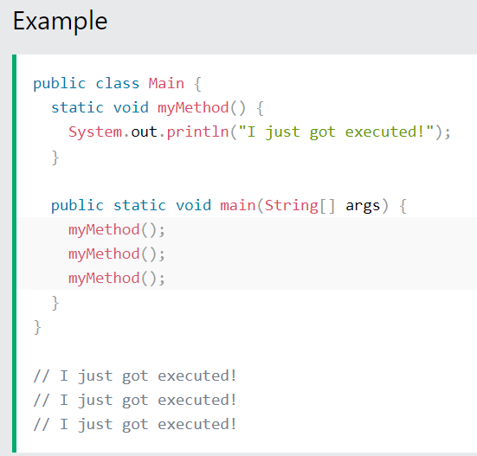
A method can also be called multiple times:

Slide 10
Java Method Parameters
Information can be passed to methods as parameter. Parameters act as variables inside the method.
Parameters are specified after the method name, inside the parentheses. You can add as many parameters as you want, just separate them with a comma.
The following example has a method that takes a String called fname as parameter. When the method is called, we pass along a first name, which is used inside the method to print the full name:

Slide 11
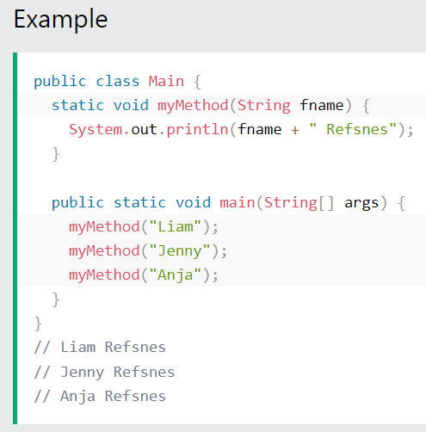
Example:

Slide 12
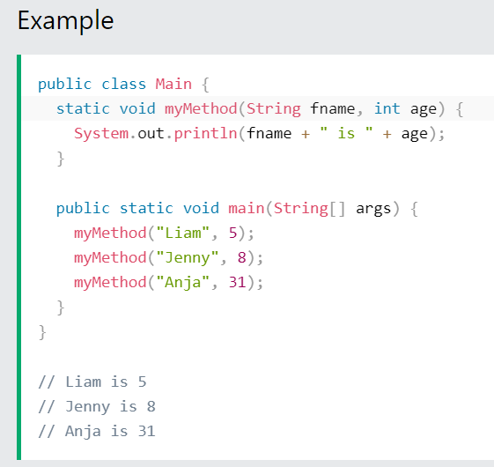
Multiple Parameters
You can have as many parameters as you like:

Slide 13
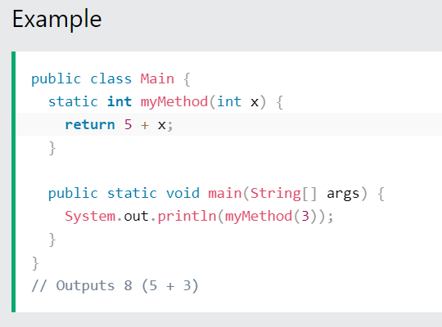
Return Values
The void keyword, used in the examples above, indicates that the method should not return a value. If you want the method to return a value, you can use a primitive data type (such as int, char, etc.) instead of void, and use the return keyword inside the method.

Slide 14
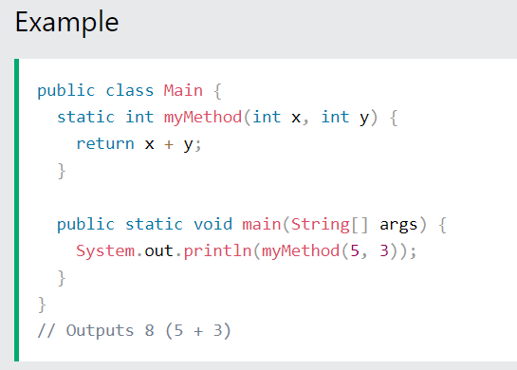
This example returns the sum of a method's two parameters:

Slide 15
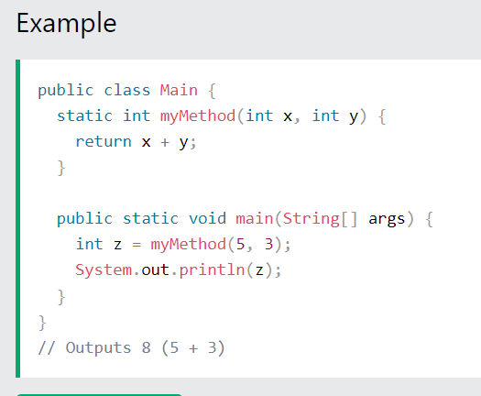
You can also store the result in a variable (recommended, as it is easier to read and maintain):

Slide 16
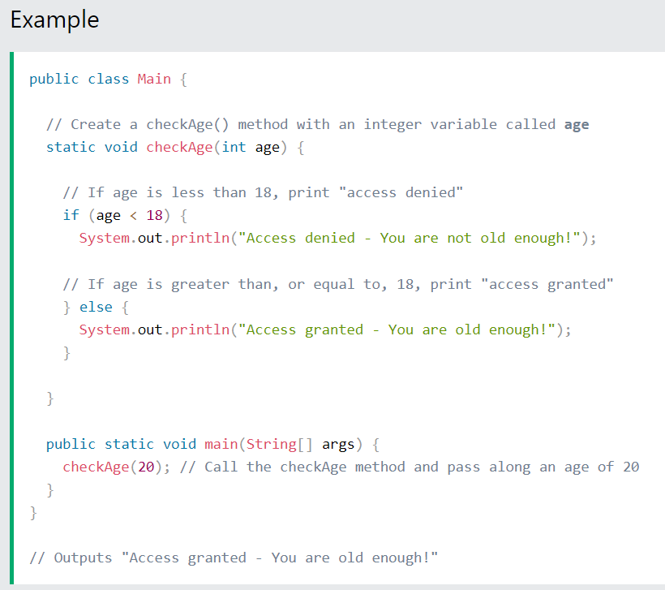
A Method with If...Else
It is common to use if...else statements inside methods:

Slide 17
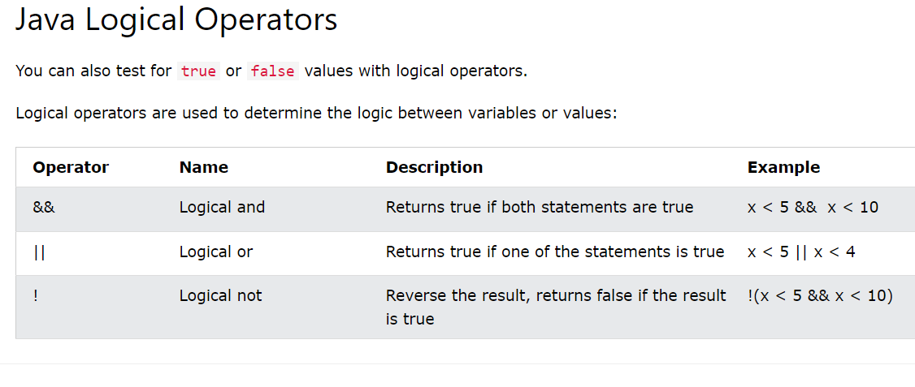

Slide 18
Built in method in Java
STRING METHODS:
toUpperCase ()
toLowerCase()
NUMBER METHODS
Math.min()
Math.round()
Math.max()
random()

Slide 19
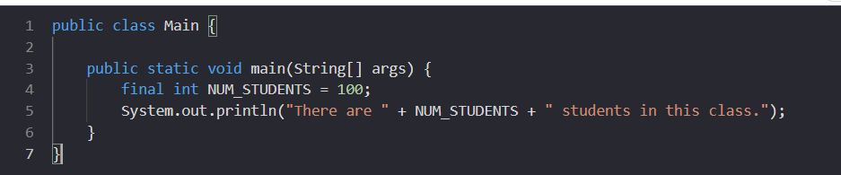
Constants in Java:
In Java, a constant is a variable whose value cannot be changed once it's assigned.
Constants are often used to represent values that will not change, such as the number of students in a class. They can also be used to make the code more readable by giving names to values that would otherwise be hard to remember.

Slide 20
Java Scope
In Java, variables are only accessible inside the region they are created. This is called scope.

Slide 21
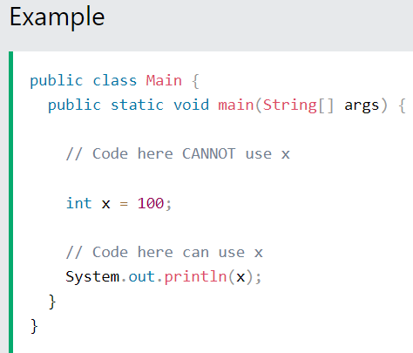
Method Scope
Variables declared directly inside a method are available anywhere in the method following the line of code in which they were declared:

Slide 22
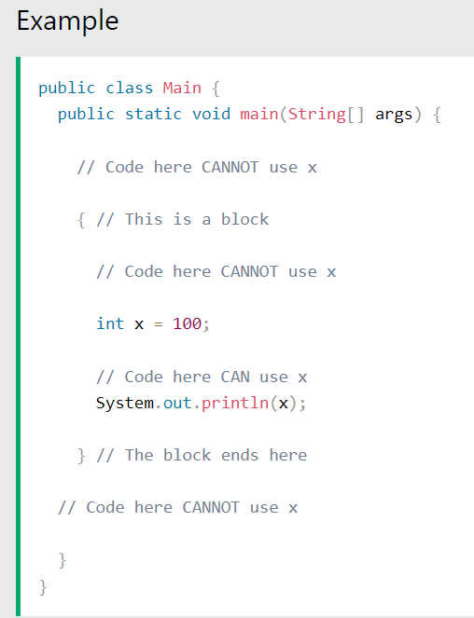
Block Scope
A block of code refers to all of the code between curly braces {}.
Variables declared inside blocks of code are only accessible by the code between the curly braces, which follows the line in which the variable was declared:

Slide 23
Java - What is OOP?
OOP stands for Object-Oriented Programming.
Procedural programming is about writing procedures or methods that perform operations on the data, while object-oriented programming is about creating objects that contain both data and methods.
Object-oriented programming has several advantages over procedural programming:
OOP is faster and easier to execute
OOP provides a clear structure for the programs
OOP helps to keep the Java code DRY "Don't Repeat Yourself", and makes the code easier to maintain, modify and debug
OOP makes it possible to create full reusable applications with less code and shorter development time

Slide 24
Java Classes/Objects
Java is an object-oriented programming language.
Everything in Java is associated with classes and objects, along with its attributes and methods. For example: in real life, a car is an object. The car has attributes, such as weight and color, and methods, such as drive and brake.
A Class is like an object constructor, or a "blueprint" for creating objects.

Slide 25
What is a class in Java
A class is a group of objects which have common properties. It is a template or blueprint from which objects are created. It is a logical entity. It can't be physical.
A class in Java can contain:
Fields
Methods
Constructors
Blocks
Nested class and interface

Slide 26
Syntax to declare a class
class <class_name>{
field;
method;
}

Slide 27
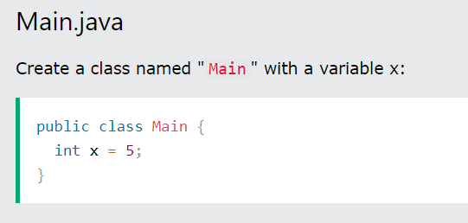
Create a Class
To create a class, use the keyword class:
Main.java
Remember from the Java Syntax chapter that a class should always start with an uppercase first letter, and that the name of the java file should match the class name

Slide 28
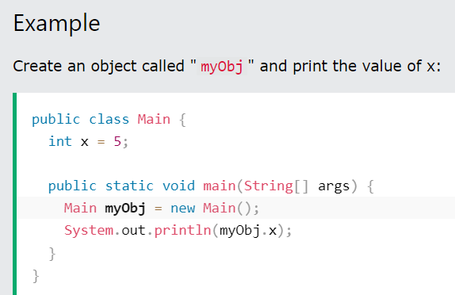
Create an Object
In Java, an object is created from a class. We have already created the class named Main, so now we can use this to create objects.
To create an object of Main, specify the class name, followed by the object name, and use the keyword new:

Slide 29
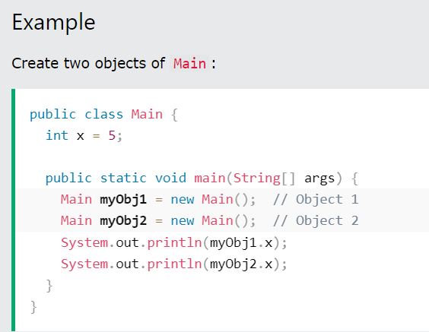
Multiple Objects
You can create multiple objects of one class:

Slide 30
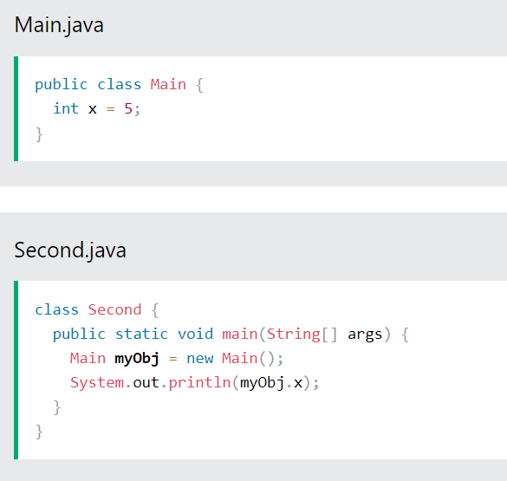
Using Multiple Classes
You can also create an object of a class and access it in another class. This is often used for better organization of classes (one class has all the attributes and methods, while the other class holds the main() method (code to be executed)).
Remember that the name of the java file should match the class name. In this example, we have created two files in the same directory/folder:
Main.java
Second.java

Slide 31
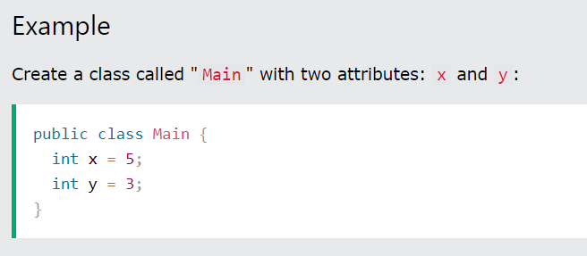
Java Class Attributes
In the previous chapter, we used the term "variable" for x in the example (as shown below). It is actually an attribute of the class. Or you could say that class attributes are variables within a class:

Slide 32
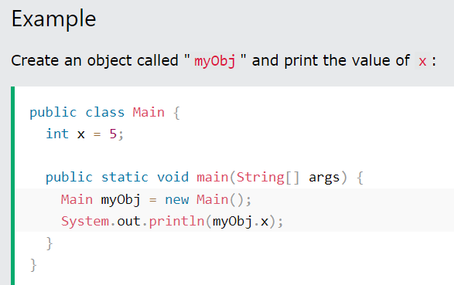
Accessing Attributes
You can access attributes by creating an object of the class, and by using the dot syntax (.):
The following example will create an object of the Main class, with the name myObj. We use the x attribute on the object to print its value:

Slide 33
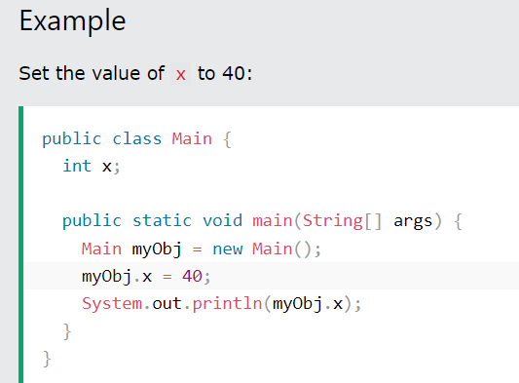
Modify Attributes
You can also modify attribute values:

Slide 34
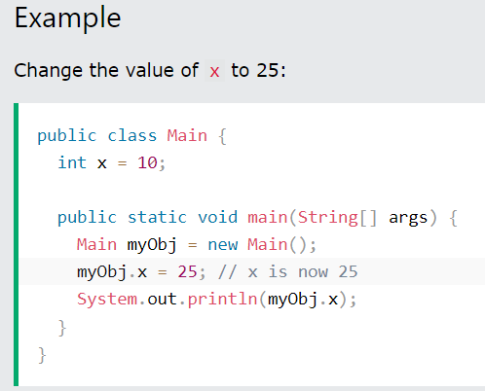
Or override existing values:

Slide 35
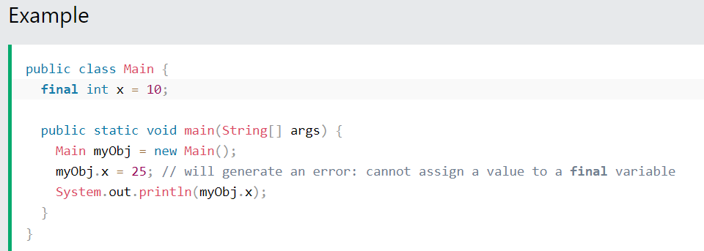
If you don't want the ability to override existing values, declare the attribute as final:

Slide 36
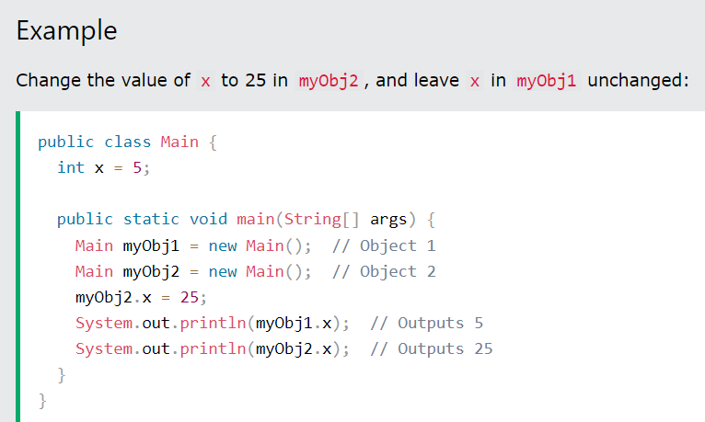
Multiple Objects
If you create multiple objects of one class, you can change the attribute values in one object, without affecting the attribute values in the other:

Slide 37
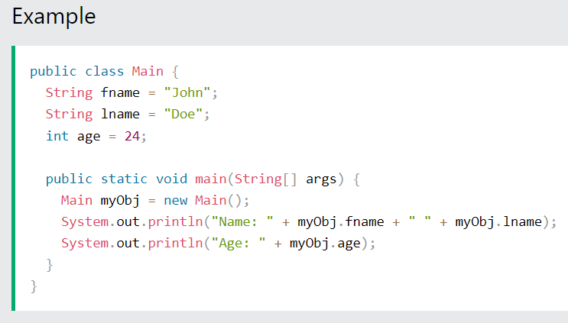
Multiple Attributes
You can specify as many attributes as you want

Slide 38
Instance variable in Java
A variable which is created inside the class but outside the method is known as an instance variable. Instance variable doesn't get memory at compile time. It gets memory at runtime when an object or instance is created. That is why it is known as an instance variable.

Slide 39
Object and Class Example: main within the class
In this example, we have created a Student class which has two data members id and name. We are creating the object of the Student class by new keyword and printing the object's value.
Here, we are creating a main() method inside the class.

Slide 40
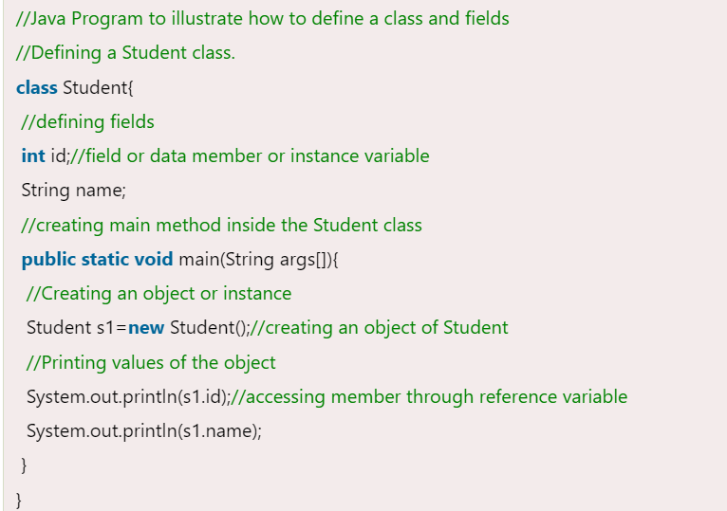
Example:

Slide 41
Object and Class Example: main outside the class
In real time development, we create classes and use it from another class. It is a better approach than previous one. Let's see a simple example, where we are having main() method in another class.
We can have multiple classes in different Java files or single Java file. If you define multiple classes in a single Java source file, it is a good idea to save the file name with the class name which has main() method.

Slide 42
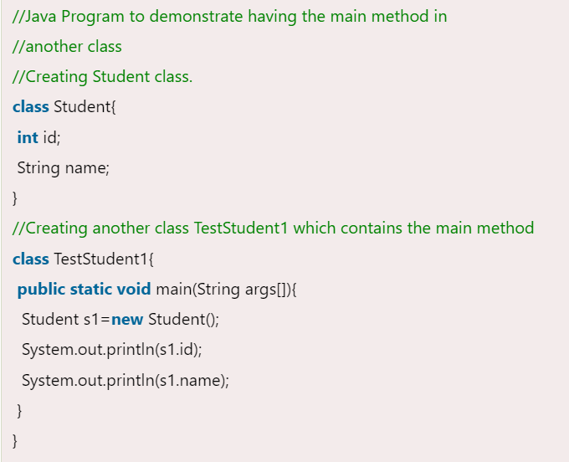
Example
File: TestStudent1.java

Slide 43
Resources:
https://www.w3schools.com
https://www.javatpoint.com/object-and-class-in-java

